Slide 1
Understanding Health and Wellness through Microbiome research
30th July – 1st August 2025
Dr. Tarini Shankar Ghosh
Microbiome Informatics
IIIT-Delhi
Day 3
Lecture 4

Slide 2
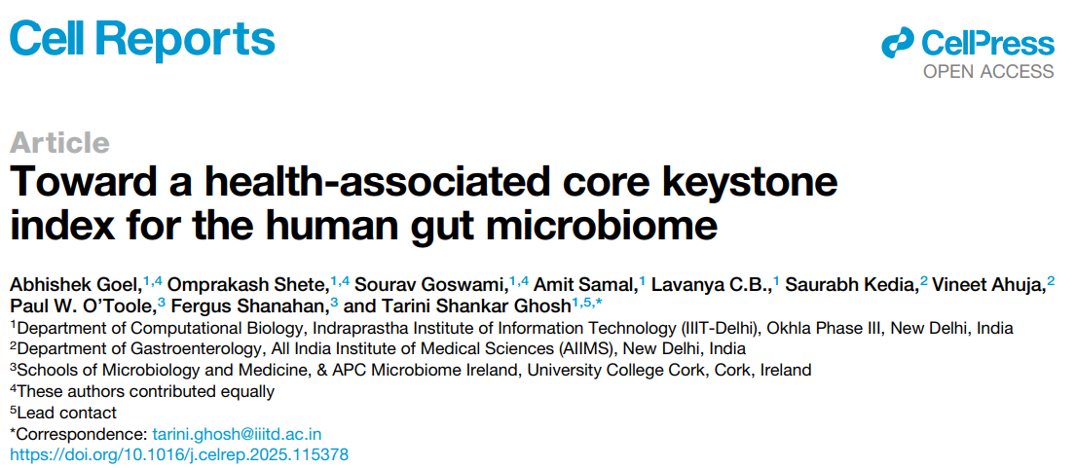
Case Studies: Obtaining insights using publicly available data
Global Ranking of 201 gut microbes using large microbiome data collection

Slide 3
What we will cover here
General introduction to gut microbiome and what problems we face to build universal microbiome-derived therapeutics/diagnostics (will be slight repeat so we will move fast here)
How did we address it using public data?
Some applications

Slide 4
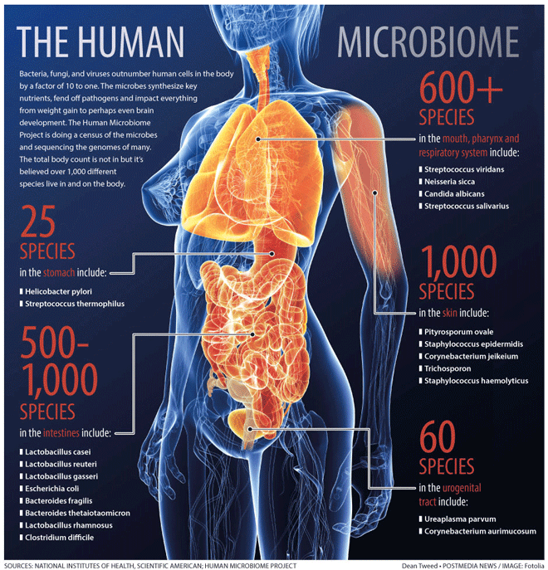
What is the human microbiome
100 trillion symbiotic microbes
Bacteria, Archaea, Fungi, Viruses & Protists
95% in our gut
Microbial Cells: Human Cells = 1.3:1
Microbial Genes: Human Genes = 150:1
We are more Microbial than Human !!

Slide 5
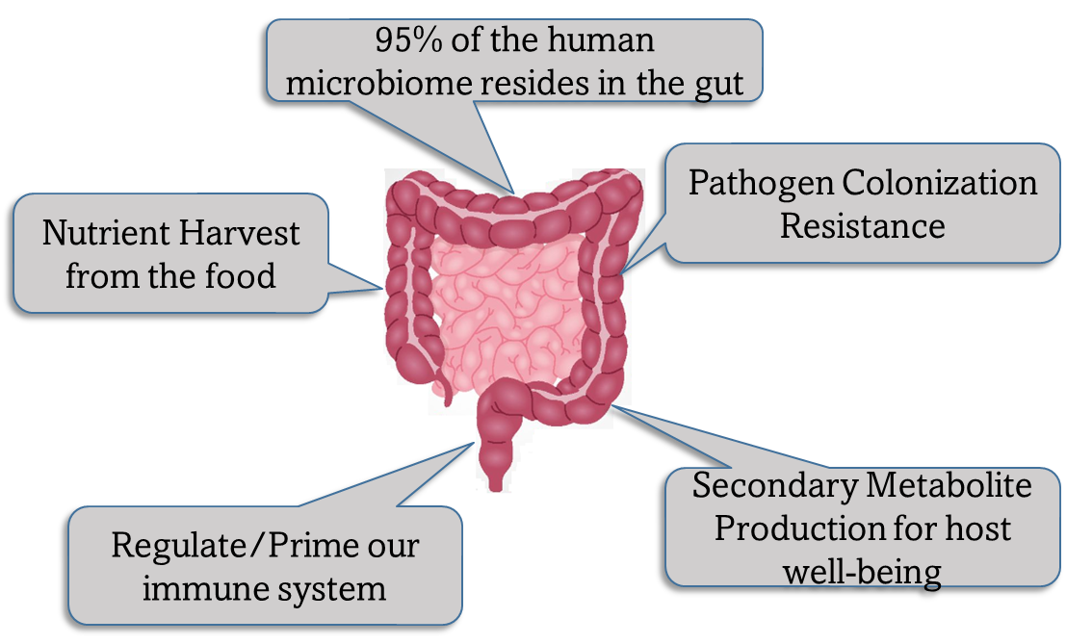
Gut is most crucial human microbiome

Slide 6
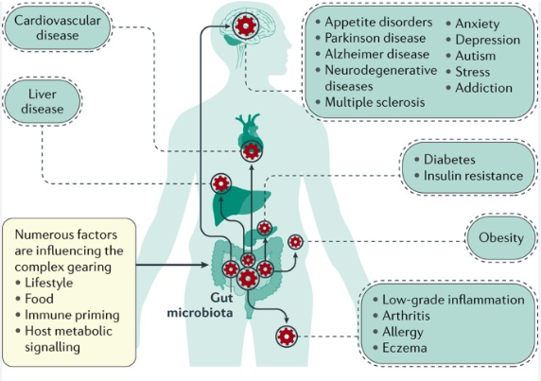
90% of the diseases have some association with the gut microbiome
Cani et al 2017, Nature Reviews Gastroenterology and Hepatology

Slide 7
The promise of the gut microbiome in diagnostics and therapeutics
Stratification
Genetics & Birth mode
Transducer
Diagnostics
Sensor
Life-style
Host physiology & function
Gender
Gut Microbiome
Age
Modulator
Diet
Diagnostics + Therapeutics
Medications
Amenable
Transmission
For that, we need to know what are the markers of health in the gut microbiome

Slide 8
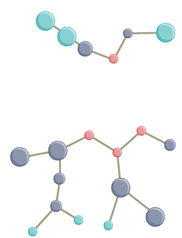
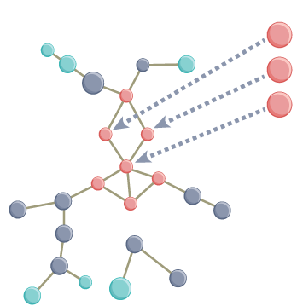
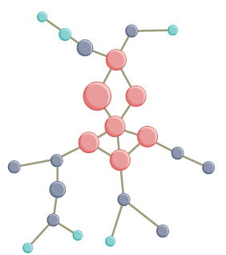
Restoration of the microbiome as a therapeutic strategy
Microbes that beneficially impact the gut ecosystem and the host
Unstable and Unhealthy Microbiome
Microbiome Supplementation (or Probiotics)
Restored Microbiome
Prebiotics
Diet
Microbiome Supplementation (or Probiotics)
Enrich the beneficial microbes of the gut ecosystem
To build efficient microbiome-associated therapeutics, we need to know what are the ideal markers of microbiome and host health

Slide 9
Challenges
Microbiome of normal individuals varies across populations and confound disease links
Bias towards industrialized societies, lack of representation of LMICS

Slide 10


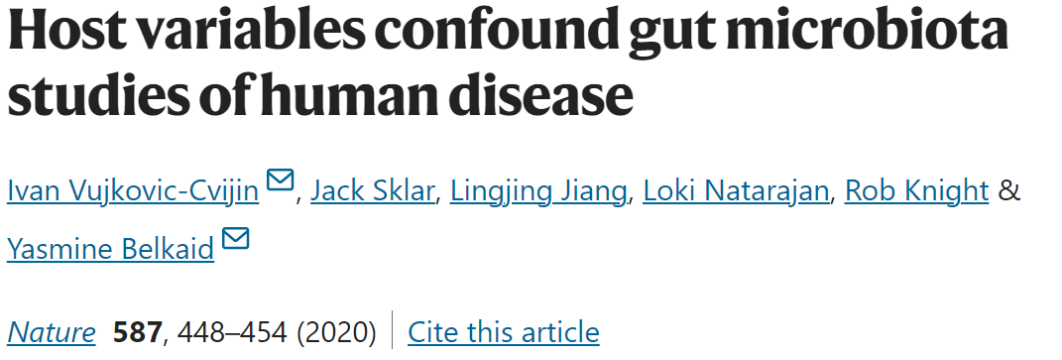

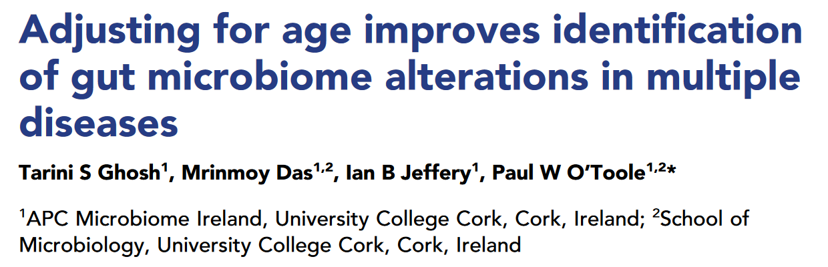
Health-associated markers vary depending upon several host-linked factors

Slide 11
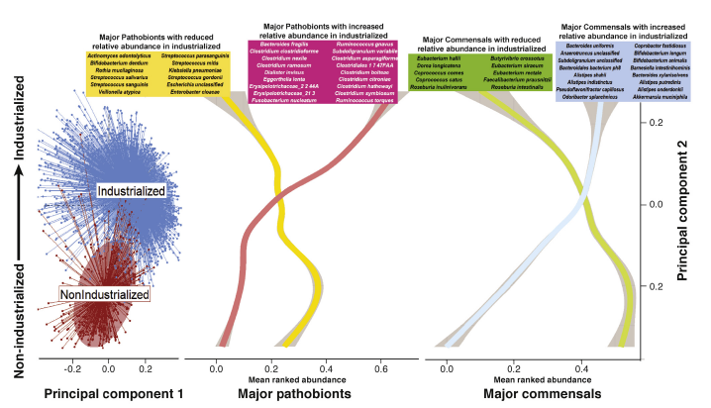
Different populations have different sets of health-associated and disease-associated microbes
Shanahan, Ghosh, O’Toole, Gastroenterology 160:483-494

Slide 12
Data collection
Gut Microbiomes
Human Microbiome Derived Genomes
2,70,000 (150,000 processed)
1,50,000 genomes
WGS: 52,000
16S: 98,000
72,000 high-quality genomes
4,735 microbiome-associated species
Humann2 generated taxa+function profiles
863 studies, 78 countries
Dada2 + SPINGO generated taxa profiles
Dada2 + strainphlan derived generated strain profiles
Oral Microbiomes
Functional Annotation
GRiD estimated species-specific growth rates
CAZyME
PFam
KEGG Reaction
~34,000 (processed)
WGS: 2,000
16S: 32,000
COG
E.C. Number
KEGG Ortholog
BiGG
KEGG Module
TMHMM/SignalP
137 studies, 41 countries
Statistical and Machine Learning
LHTM/Time-Series Analysis
Genome/Protein Scale Language Models for novel function prediction/annotation
Meta-Analysis
Genome/Gene-level Co-phylogeny and Network Analysis

Slide 13
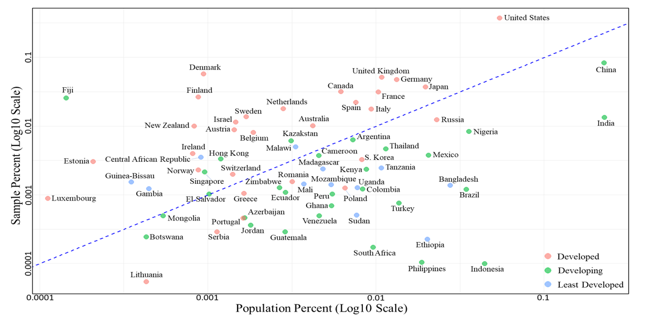
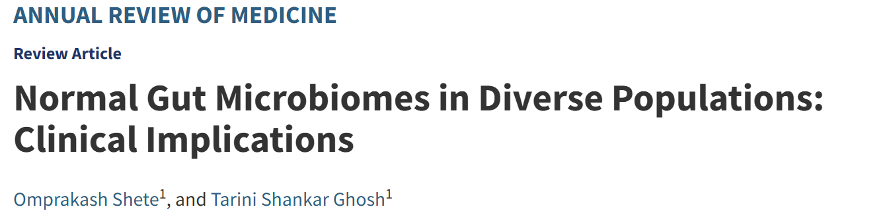
Representation of different nationalities

Slide 14
Challenges
Context-dependent association of microbes with disease
Same microbe can be positively associated with one disease and negatively with others
Different strains/variants of the same microbe can associate differently with different diseases

Slide 15

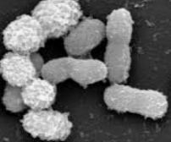
Good Bug and Bad Bug as well
Next Generation Probiotic
Product
https://fr.hebronnutrition.com/products/pendulum-akkermansia-the-only-brand-with-akkermansia-a-live-probiotic-supplement-capsule-for-women-and-men-increases-glp-1-improves-digestive-health-includes-fiber?variant=43972529127644&stkn=fdda09d0fa89&gad_source=1&gclid=Cj0KCQiAo5u6BhDJARIsAAVoDWtJDFlYsRF4jVjMBb67-7xiV5ZuSmp7kLbMsBzLKiJa-cpgGvGZFzQaAvdjEALw_wcB
Obesity
Type II Diabetes
Appetite Dysregulation
Cardiovascular Diseases
Inflammation
Parkinsons
Disease
Deteriorates
Ameliorates
Akkermansia muciniphila

Slide 16
The big question…????
Are universal hallmarks of microbiome resilience and health not identifiable?
How do we select for the markers of health to restore?

Slide 17
An alternative approach: To assume a continuum or gradient
Not to universal stereotypes
Good Bug
v/s
Bad Bug
To assume a continuum or rank based on consistency of associations and prioritize targets
Health-Association
Not Associated

Slide 18
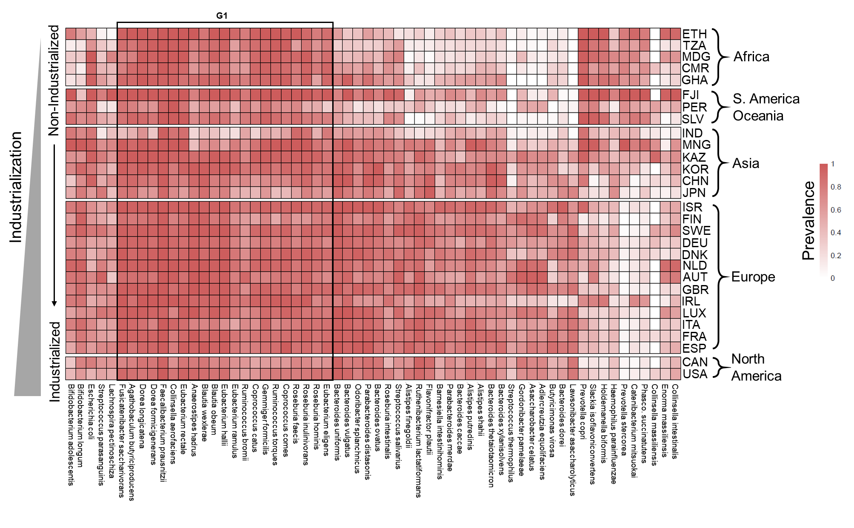
Varying degrees of association of microbes with a ‘healthy’ microbiome across globe: Some more frequent than others
Overall prevalence of different microbes in healthy gut microbiomes across the world
Shete, Ghosh, Annual Review of Medicine, 2024

Slide 19
Overall Approach
Microbes reduced in disease
Microbes reduced in disease
Microbes reduced in disease
Ranked Index
Microbiome Datasets across globes from different diseases across different populations
Rank taxa based on consistency
Microbes reduced in disease
Microbes reduced in disease
Microbes reduced in disease

Slide 20
Other properties are also important
Prevalence
Influence
Core-Association
Remember Anna Karenina Principle …..
A good microbe is someone which is not simply associated with health but also is easily accepted into the baseline gut microbiome

Slide 21
Other properties are also important
Stability
Long Stability
Microbiome 1 (T1)
Microbiome 1 (T2)
Microbiome 2 (T1)
Microbiome 2 (T2)
Low Stability
High Stability
A good microbe should also be associated with long-term stability of the microbiome

Slide 22
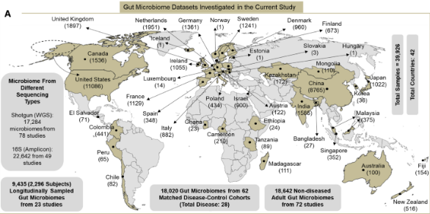
Large global gut microbiome investigation

Slide 23
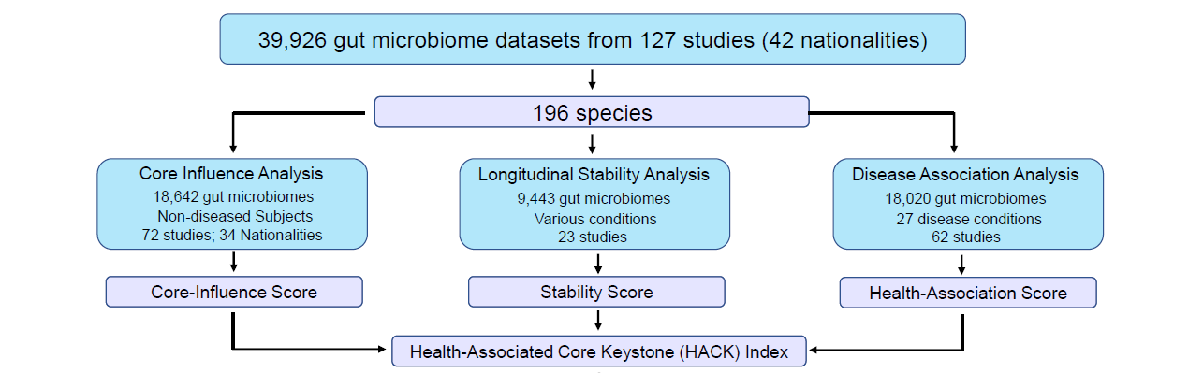
HACK index
201 species
Candidate universal probiotics
201 species

Slide 24
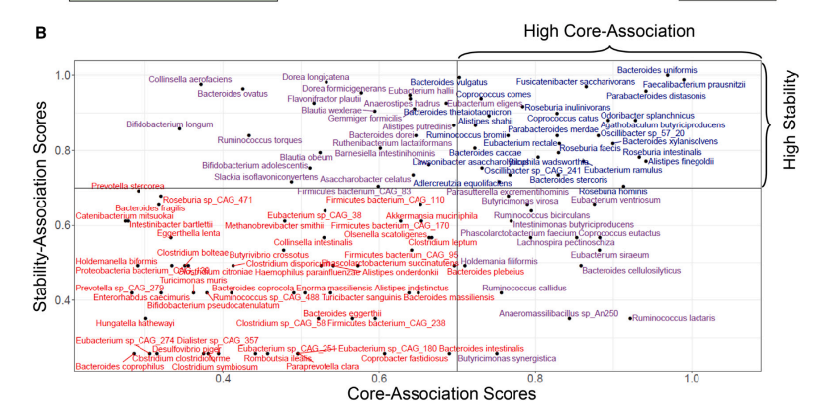
Example.. Core and Longitudinal Stability

Slide 25
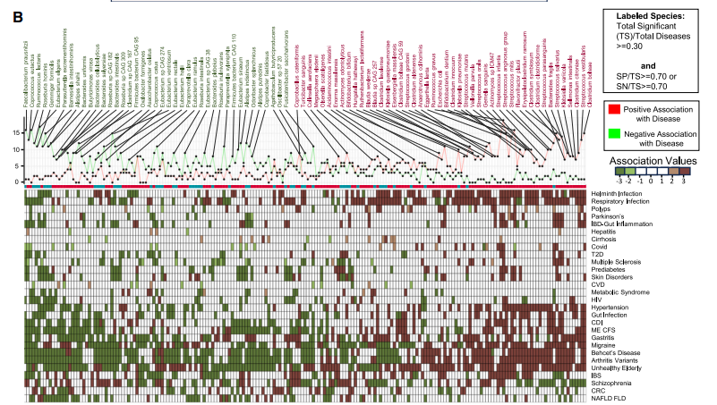
Example… Disease Association Patterns

Slide 26
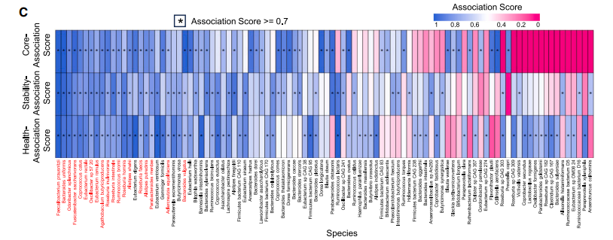
The three association scores

Slide 27
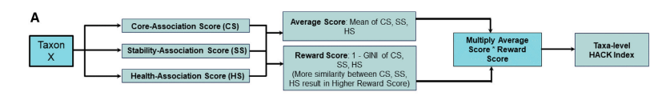
Combining the three association scores into one single HACK index

Slide 28
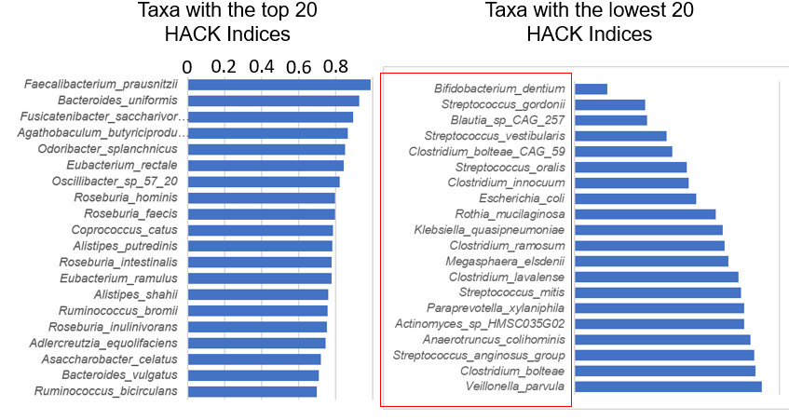
High and Low HACK index taxa

Slide 29
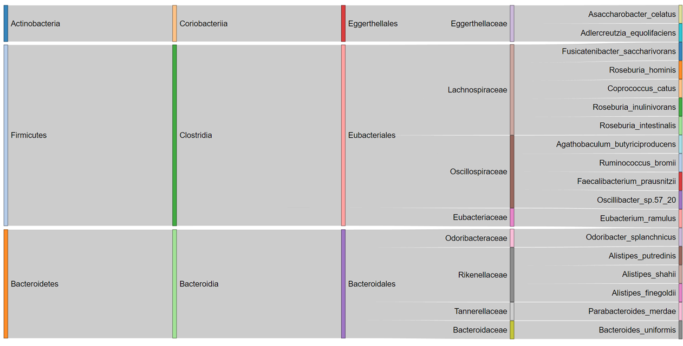
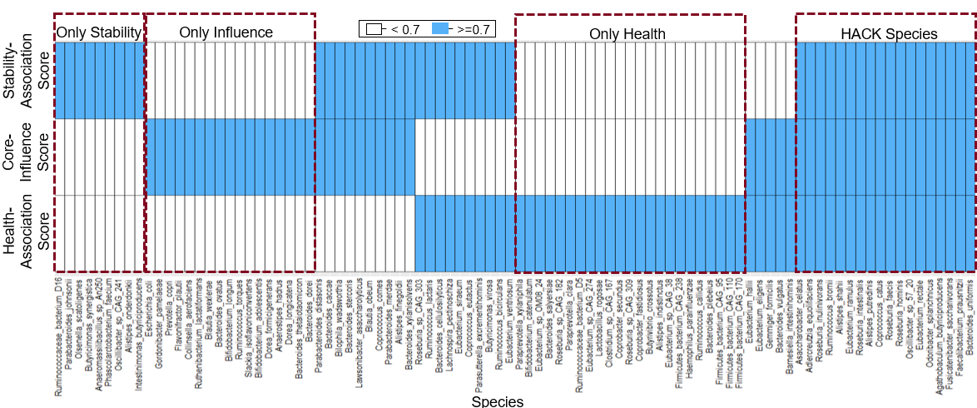
Top-17 microbes based on this index
Health-Associated
Core Keystones (HACKs)

Slide 30
Validation of HACK index
Validation in sub-cohorts within the Discovery cohorts coming from different kinds of populations
Validation in unseen validation cohorts (5500 gut microbiomes from 14 different study cohorts)

Slide 31
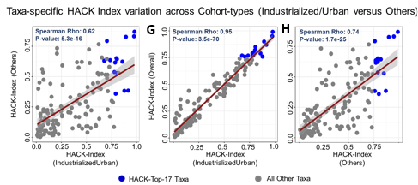
The order is significantly reproducible across populations

Slide 32
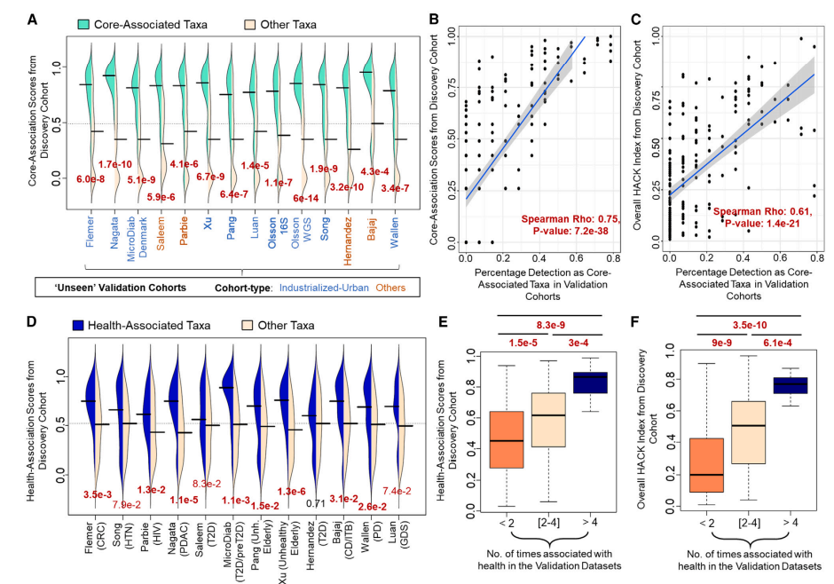
Ranking order is significantly similar in a completely different validation cohort

Slide 33
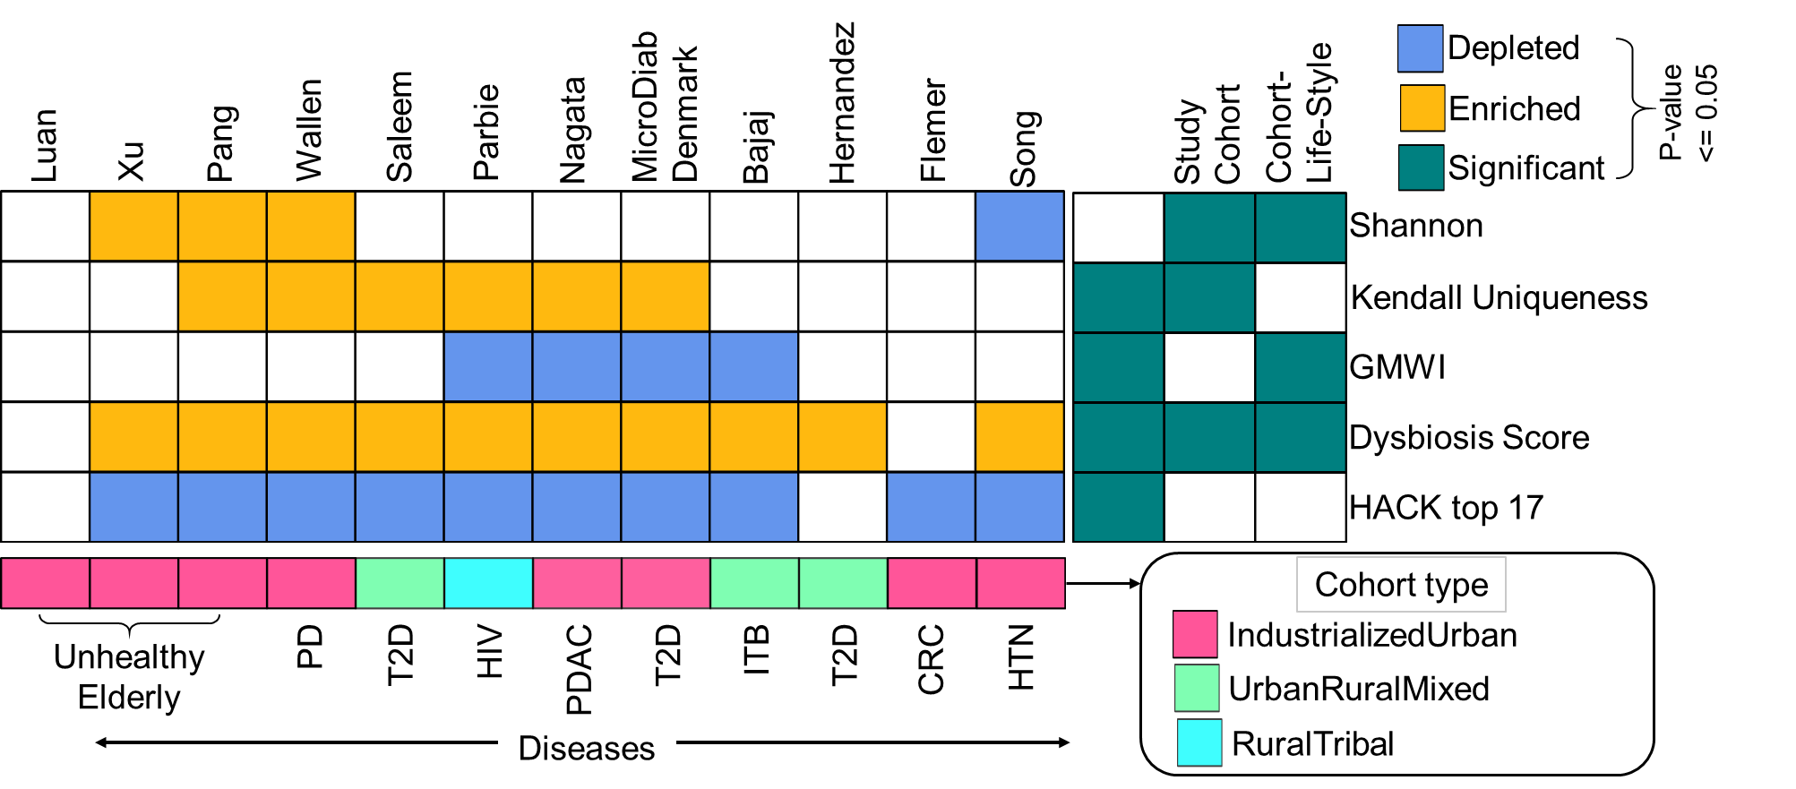
The top 17 microbes are consistently associated with health and do not show population-specific variability

Slide 34
Using HACK index to identify microbes that facilitate response to treatments in new validation cohorts
Mediterranean Diet Intervention
Immuno-Checkpoint Inhibitor Therapy Response

Slide 35
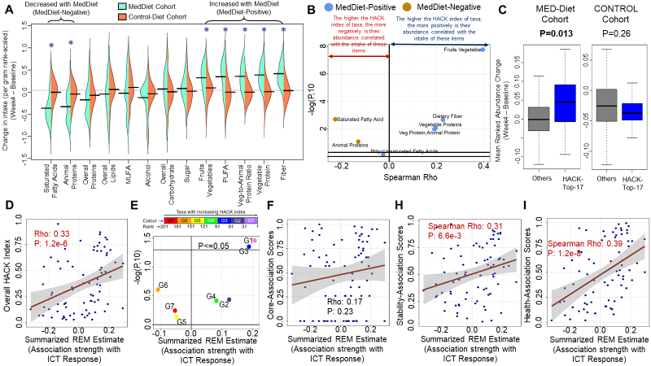
The top microbes on this list are consistently associated with improved response to diet and immuno-checkpoint inhibitor therapy in cancer
Top17 show significant enrichment in the MedDiet cohort
The higher the HACK index of taxa the stronger is the association with ICT responders

Slide 36
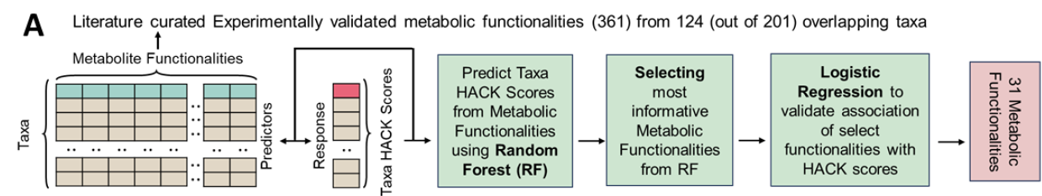
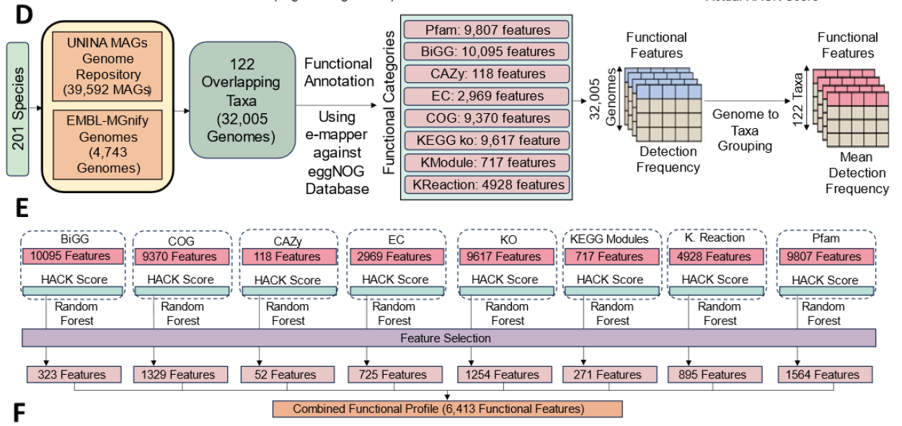
Functional investigation of genomic features associated with high HACK index

Slide 37
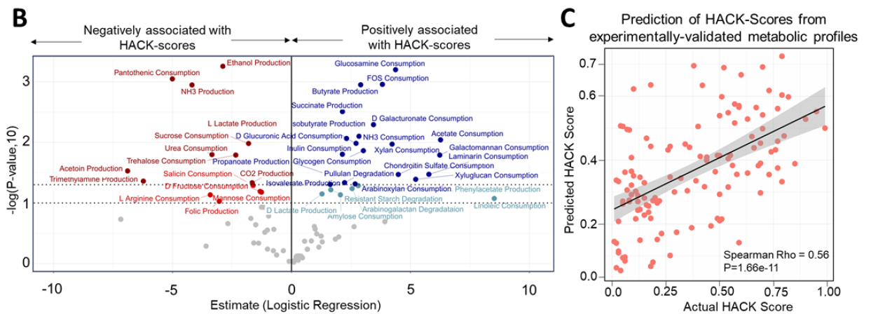
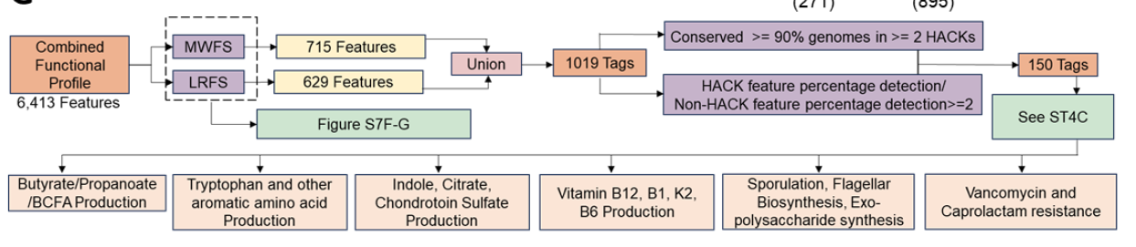
What we find
We also provide a panel of genes that can be investigated further

Slide 38
Summarize
Universal ranking order of taxa based on their association with health, stability of the microbiome
Ranking order is reproducible across global populations (despite variations in the overall normal microbiome composition)
Taxa higher up in the list are associated with health, and are associated with response to different kinds of microbiome-associated interventions.
Functions associated with HACK indices include those associated with multiple themes: inflammation, gut-brain axis, sugar homeostasis, immune-checkpoint therapy response, diet response
Future Directions: Dip-stick assay or qPCR based assays of only the 17 taxa (in talks of commercial entities and clinicians)

